Slide 1
MIT Media Lab
Presented by Gauri Gupta

Slide 2
Research Areas
Privacy Preserving Machine Learning
Deep Learning
Generative Modelling
Secure Multiparty Computation
Graph learning

Slide 3
Synthetic Tabular Data Generation

Slide 4
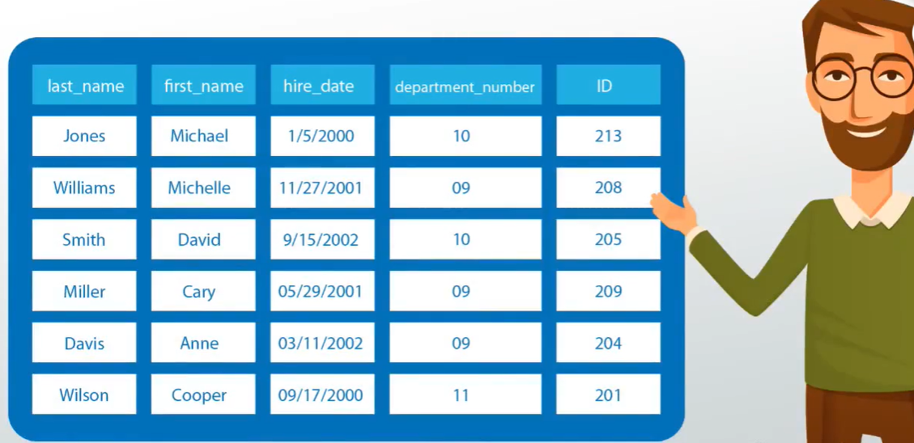
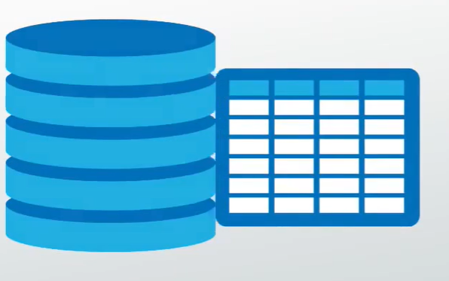
Tabular Data: Why the need for it?
Census results
Health care records
Employee data
Customer Data
Financial Data
Notes:
Today, massive amounts of data, including census results, health care records, data of employees and customers are all stored in a tabular format. Tables helps us to store large amounts of correlated data in an easy, concise and an organized manner. Such data is valuable because it contains useful patterns that can help in decision-making and many other downstream tasks.​

Slide 5
Challenges involved in dealing with Real Data
Poor quality- outliers, missing values
Privacy issues – contains personal and sensitive information
Data Imbalance - data distribution is highly imbalanced
Notes:
But some of the challenges involved in dealing with real data are:
1. Quality of the data — for example, missing values and outliers from people incorrectly filling in a form or questionnaire
2. The real data is very strictly regulated due to privacy issues which restricts data sharing across companies. for example, when the data contains personal information, it becomes necessary for companies to protect the privacy of the customers. The regulations in data sharing due to privacy converns are moving very fast with laws like GDPR, HIPAA, SHIELD etc.
3. Data imbalance. The data distribution of categorical columns is highly imbalanced, and we have skewed distributions for continuous columns.

Slide 6
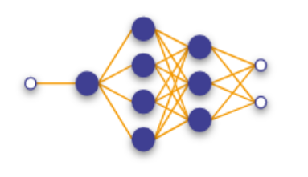
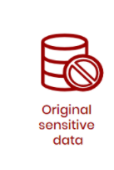
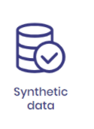
Solution: Generate Synthetic Data
Notes:
So, all of this motivates to generate alternative synthetic data

Slide 7
Research Significance of Synthetic Data
Poor quality-repairing and enhancing data
Privacy issues –preserve correlations but remove sensitive information
Data Imbalance - learn distribution & supplement using synthetic data
Notes:
1. Learning the distribution of the underlying data helps us to address missing values and detect outliers and hence reduce the impacts of the problem of poor quality.​
2. Second, If synthetic data can anonymize sensitive information while preserving correlations, it can lead to safe data sharing removing the barrier to data disclosure.
3. Third, To tackle the problem of data imbalance, synthetic data can be used to supplement the niche data of minority classes in the table.

Slide 8
Challenges involved in Tabular Data Modelling
Mixed data types
Categorical, Numerical, Ordinal
Complicated co-relations
State = Goa Country = U.S.A. Country = India
`
Missing values
Notes:
1. Real-world tabular data consists of mixed data types (continuous, ordinal, categorical, etc.) For tabular data, we need modification to the generative models that simultaneously generate a mix of discrete and continuous columns.

Slide 9
Challenges involved in Tabular Data Modelling
Mixed data types
Categorical, Numerical, Ordinal
Complicated co-relations
State = Goa Country = U.S.A. Country = India
`
Missing values
Notes:
2. Inter variable correlations are very difficult to capture. Each column has a complicated correlation with other columns. ….for example, a data record generated as ….. Is not semantically correct.

Slide 10
Challenges involved in Tabular Data Modelling
Mixed data types
Complicated co-relations
State = Goa Country = U.S.A. Country = India
`
Missing values
Categorical, Numerical, Ordinal
Notes:
Tabular datasets usually contain data with a lot of missing values. We need to modify the data representation to properly distinguish missing values from known values and mask the model to make it robust towards missing values.

Slide 11
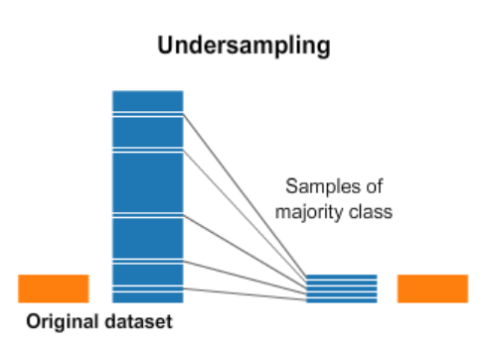
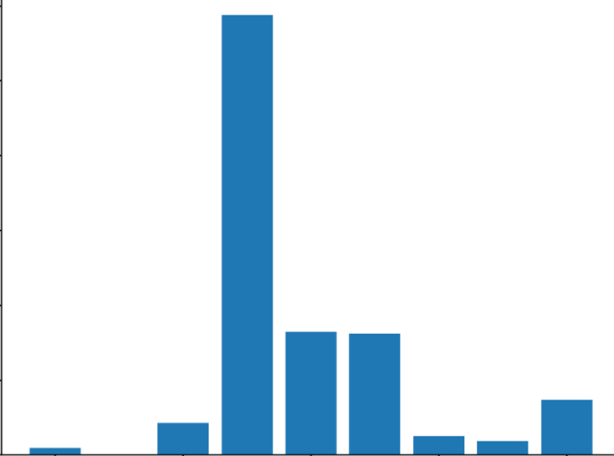
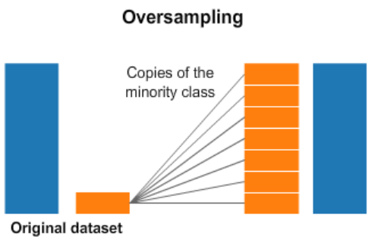
Data Imbalance in Discrete Distributions
Highly imbalanced categorical distributions
Frequency
Previous techniques
Categorical entries
Notes:
In real-world datasets, most categorical columns have a highly imbalanced distribution.
Imbalanced data leads to insufficient training opportunities for minor classes. If the training data are randomly sampled during training, the rows that fall into the minor category will not be sufficiently represented, and the generator may not be trained correctly. We neither want undersampling or oversampling because if the training data are resampled, the generator learns the resampled distribution, which is different from the real data distribution.

Slide 12
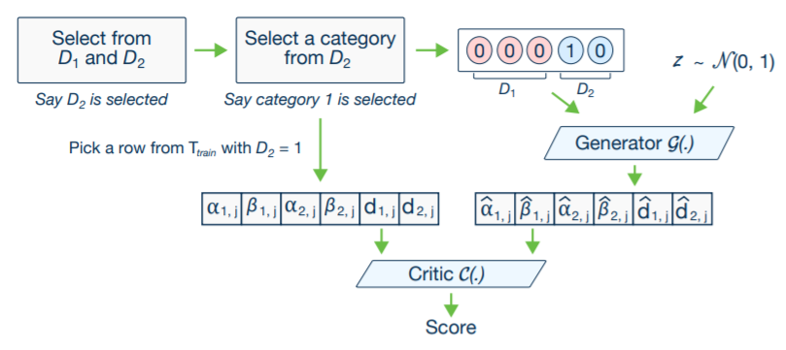
Conditional GAN and training by sampling
Source: https://arxiv.org/pdf/1907.00503.pdf
Notes:
To handle class imbalance we use conditional GAN and training by sampling
The goal is to resample efficiently so that all the categories from discrete attributes are sampled evenly during the training process, and to recover the real data distribution during the test or synthesis.
I will not go into the details of it here
Randomly select a discrete column Di out of all the discrete columns, with equal probability. For instance, in Figure, the selected column was D2, Construct a PMF across the range of values of athe column selected in 2, such that the probability mass of each value is the logarithm of its frequency in that column. Let k ∗ be a randomly selected value according to the PMF above. For instance, in Figure, the range D2 has two values and the first one was selected, so we get the mask a 00010.
Now, while training the Generator of GANs, along with the noise input to the generator of, they introduce the vector cond to indicate the condition (Di ∗ = k ∗ ). So, to enforce the conditional generation we penalize the generator by adding the cross entropy loss between the given mask m and produced class.

Slide 13
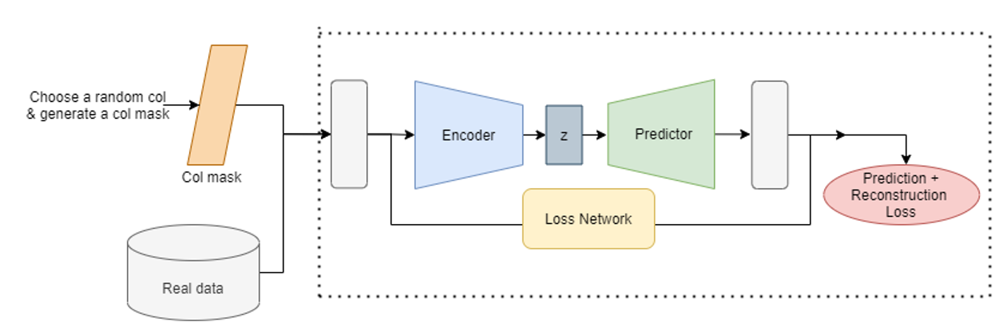
N-way Predictor Model
Pre-training N-way Predictor Model
Captures the correlations
in the underlying data
Predictor predicts the randomly masked column using the remaining columns
Notes:
We introduce an encoder-predictor model on baseline architecture.
First, We randomly select a column from the table, say Ci and generate a mask which removes that particular column from the input data. The Predictor predicts the masked out column i.e. Ci using the remaining input data. While predicting the masked out column, it also simultaneously reconstructs the other columns.
Recon loss on the remaining columns captures the correlations in the underlying data by taking the input real data to an embedding space.

Slide 14
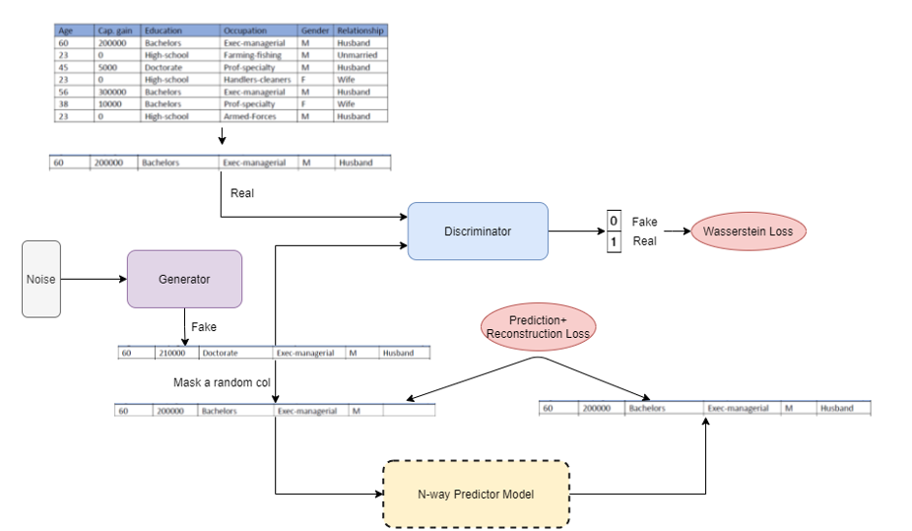
Model acrhitecture
Notes:
Now we use this pre-trained Predictor Model in the GAN architecture. We add the reconstruction and prediction loss of the predictor model to the original loss of the generator of the GAN. So, the generator while learning to produce similar fake samples through adversarial training also learns to minimise the recon and prediction loss of the predictor model on the fake generated samples and thus produce samples that are semantically correct and have higher correlations among columns.

Slide 15

Metrics for tabular data evaluation
Notes:
How do we evaluate how good is the data that we generate?”
In order to answer this question, let us look at some of the metrics that allow us to compare the real that we provide with the synthetic data generated.

Slide 16
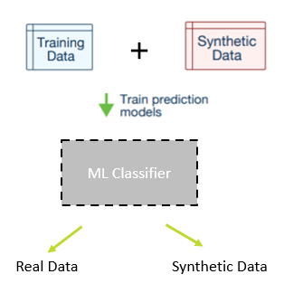
Metrics for evaluation:
Detection Metrics
Statistical Metrics
Categorical columns
CS test
Numerical columns
KS test
Notes:
Detection Metrics: These metrics evaluate how hard it is to distinguish the synthetic data from the real data by using a Machine Learning model. To do this, we will shuffle the real data and synthetic data together with flags indicating whether the data is real or synthetic, and then cross validate a Machine Learning model that tries to predict this flag.
Statistical Metrics: these metrics compare individual columns from the real table with the corresponding column from the synthetic table, and at the end report the average outcome from the test. This metric uses the Chi-Squared test to compare the distributions of two discrete columns and Kolmogorov–Smirnov test to compare the distributions of continuous columns using the empirical CDF
sdv.metrics.tabular.KSTest: This metric uses the two-sample Kolmogorov–Smirnov test to compare the distributions of continuous columns using the empirical CDF. The output for each column is 1 minus the KS Test D statistic, which indicates the maximum distance between the expected CDF and the observed CDF values.
sdv.metrics.tabular.CSTest: This metric uses the Chi-Squared test to compare the distributions of two discrete columns. The output for each column is the CSTest p-value, which indicates the probability of the two columns having been sampled from the same distribution.
ML Efficacy Metrics: This metric will evaluate whether it is possible to replace the real data with synthetic data in order to solve a Machine Learning Problem. It does this by learning a Machine Learning model on the synthetic data that tries to predict a particular column using the rest of the data and then evaluates on the real data.

Slide 17
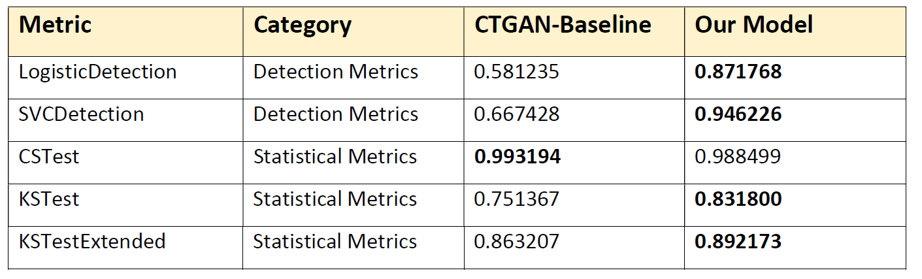
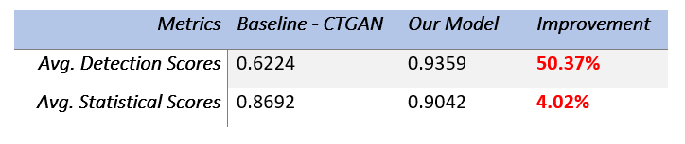
Results and Improvements on the baseline..
Notes:
We used the current state of the art model-CTGAN as the baseline and compared our model on various evaluation metrics. Our model has achieved a significant improvement of over 50% in Avg Detetion and an improvement of over 4% in the avg. Statistical scores.

Slide 18
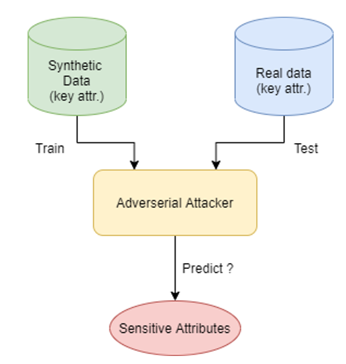
Data privacy in generative models – Threat model
Notes:
This also gives rise to the threat model in synthetic data generation
Given the synthetic data, can an attacker predict sensitive attributes in the real dataset?
These models accomplish this by fitting an adversarial attacker model on the synthetic data to predict sensitive attributes from “key” attributes and then evaluating its accuracy on the real data
Privacy Metrics: This family of metrics answers this question, given the synthetic data, can an attacker predict sensitive attributes in the real dataset? These models accomplish this by fitting an adversarial attacker model on the synthetic data to predict sensitive attributes from “key” attributes and then evaluating its accuracy on the real data.

Slide 19
Sanitizer
Semantic decoupling of sensitive information in latent space
Sampling alternatives in feature space to sanitize sensitive attributes
Generative models
Information
Removal
How to sanitize data?
Sampling from data distribution
Removal of correlated features
Inability to preserve non-sensitive information
Low Privacy-utility trade-offs
Notes:
There are different ways we can achive sanitization in data
by information removal or ii) sanitization by sampling from data distribution.
In the first case, we can remove information using adversarial or by adding noise to representations. The second case requires removing a lot of correlated features to achieve satisfactory sanitization.
In The second category we use generative modelling to synthesize new samples from the same underlying data distribution but are not the exact samples from the sensitive dataset. However, it is unable to preserve any non-sensitive information for the training datapoints since they re-sample from the distribution.
Both sets of methods provide relatively low privacy-utility trade-off due to their inability to preserve the non-sensitive information while eliminating the sensitive information.
Sanitizer introduced a two-step method. 1. semantic decoupling of sensitive information in latent space 2. sampling alternatives in feature space to sanitize sensitive attributes

Slide 20
Utility vs Privacy
Data Utility
Raw Data
Sanitizer
Information removal/ Generative modelling
Data Privacy

Slide 21
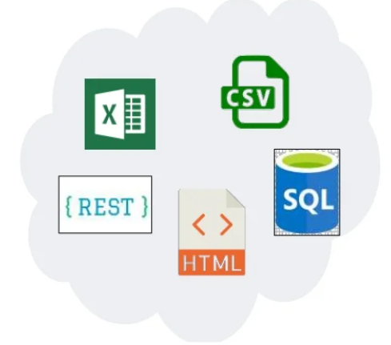
Privacy in Tabular Data
Data Sharing
Financial Services
Healthcare
Customer data
Banks
Insurance
Employee data
Notes:
Most of The industrial datasets with different stakeholders like banks, insurance companies, and health care, employee data store their data in the form of tables.
And as we saw modelling these datasets presents multiple challenges along with the privacy regulations in haring them

Slide 22
Extend Support to Sanitizer
Notes:
Currently supported on images
Extend to tabular data as the same modelling framework might not work
Tabular data has its own challenges like – unbalanced data, mixed data types, complicated correlations etc.
Further extend to time-series data, relational databases
populated with both continuous and categorical variables, or a mix of the two, e.g.,
missing values can be considered to be categorical elements embedded incontinuous variables as they are clearly separate from the continuous variable’s original distribution. Here, such type of variables are termed as "mixed" variables.
numeric data variables often have a wide range of values as well as a skewed distributions, e.g., the statistic of the transaction amount for a credit card. Most transactions should be within 0 and 500 bucks (i.e. daily shopping for food and clothes), but exceptions of a high transaction amount surely exist.

Slide 23
Privacy in Urban Sensing with Instrumented Fleets, Using Air Pollution Monitoring

Slide 24
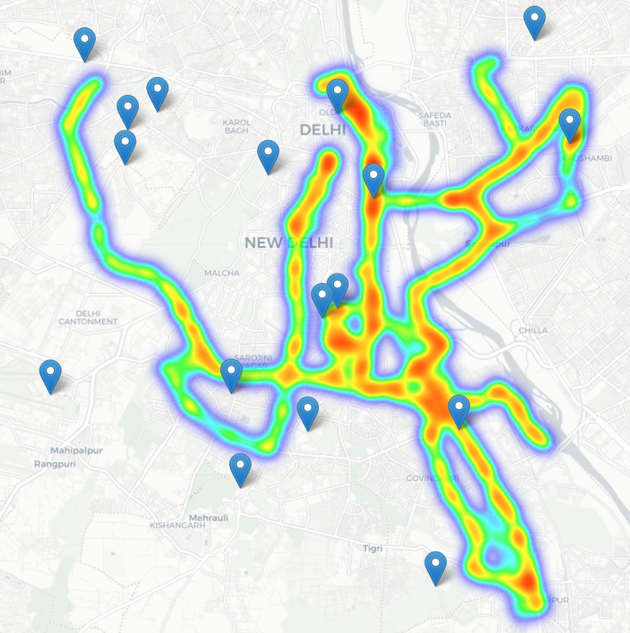
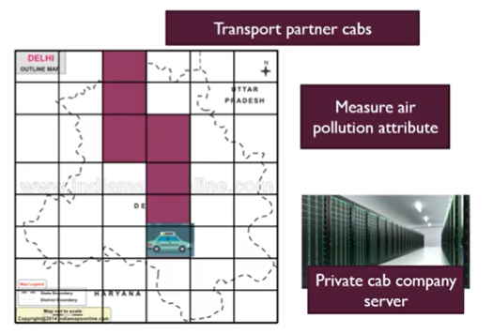
Introduction
Notes:
The problem involves responding to client queries based on pollution data collected by various cab and delivery companies for a particular city.
To introduce the problem of privacy in urban sensing, consider a scalable sensing of particular matter. Here to measure air pollution, cabs/fleet/food delivery companies are fitted with PM sensors to measure PM values and GPS sensors to tag the data location. Now, these fleets measure the air pollution values as they roam around the city.
Vehicle mounted sensing holds great promise to scale up
urban measurements. Figure 1 shows an example of the spatial
coverage by 3 public bus routes in New Delhi, India, where
we instrument the buses with air pollution monitoring sensors.
The government deployed static pollution sensors, marked
as landmark icons in the same figure, show significantly
lower spatial coverage compared to the bus mounted sensors.
Increasing bus count along some routes further increases the
temporal granularity of sensed values, as each bus remains
active for 16-18 hours per day. While public buses cover the
main arterial roads in a city, other vehicle fleets like cab sharing
services, food and essential goods delivery services cover much
wider area. Urban sensing, therefore, can see a dramatic shift
leveraging thousands of mobile probes in cities, in the form
of cab fleets [2], [3], e-commerce or food delivery vehicles.
Fleet owners are themselves realizing this potential of scalable
urban sensing.

Slide 25
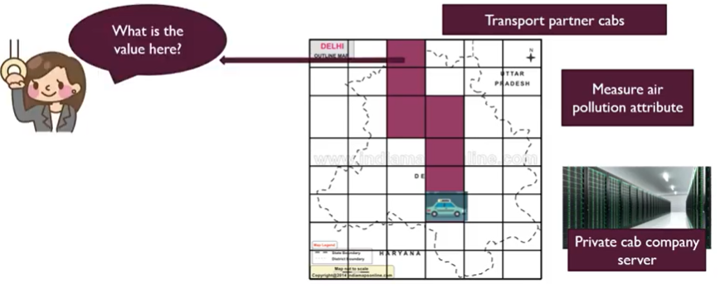
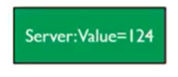
Notes:
When a client queries a particular location, the server answers the PM values,

Slide 26
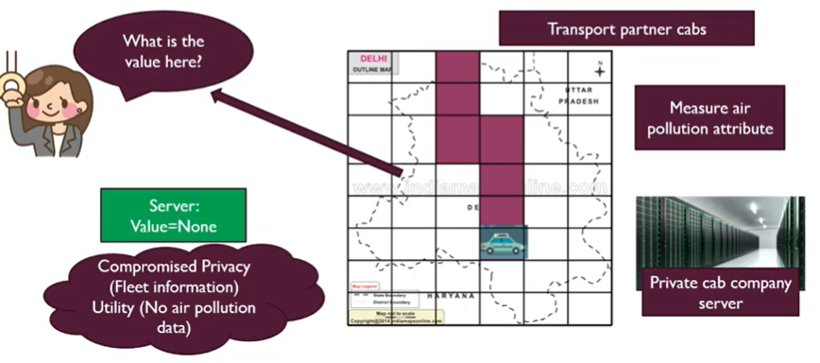
Notes:
But what about when the query location does not have any particular value. In this case, if the server answers that there is no value. This gives rise to utiity and privacy problem. We want to respond to each and every query of the clients while the privacy problem for server is that it does not reveal the information of location of cabs and fleet size as this will reveal their business model.
Interpolation computes missing values at uniformly sampled grid points in the city. This step hides locations where vehicles are missing. Interpolation is a necessity not only for fleet privacy to hide where vehicles are present vs. absent, but also for improved utility to give reasonable response at locations without vehicles.

Slide 27
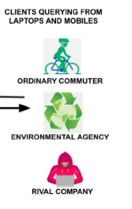
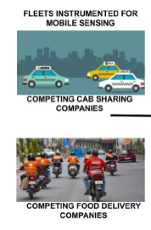
What is private?
Clients – Query locations
Fleets –Fleet size, location and time
Notes:
Publishing sensor data tagged with time and location of data collection violates privacy. Rival companies, e.g. Lyft vs. Uber can use the spatial
distribution information of the instrumented fleet, for better placement and routing of their competing fleets. On the other hand, sensor data clients also wants to preserve the location privacy for their sensor data query. The exact locations queried by these clients is sensitive information,
which must be protected as well.
An end-to-end system for preserving privacy of both fleet owners and data clients, while maintaining, utility of the sensed data.

Slide 28
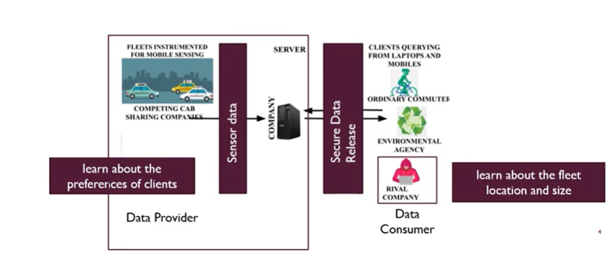
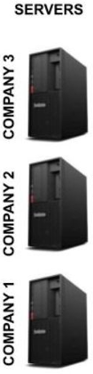
Threat Model
Sensitive data containing location and time
Notes:
This gives the underlying threat model where cabs act as data provider and wants to learn about the clients query locations.
Whereas rival companies acting as data consumer wants to learn about the business model of the transport partners.

Slide 29
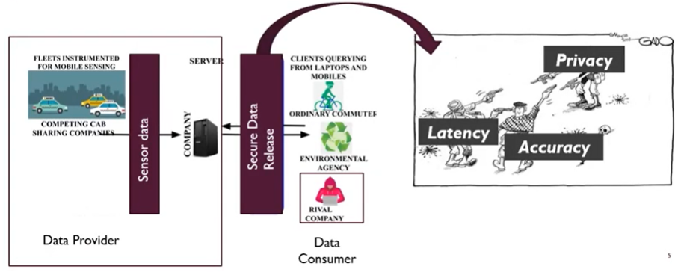
Notes:
To preserve privacy in such scenario, we release data securely balancing the trade-offs between privacy, accuracy and latency

Slide 30
Ways to protect data
Anonymize
Obfuscate – Differential Privacy
Encrypt – Secure MPC
Notes:
Now there are different ways to protect the sensitive data and release it securely-
In our work, we explore both DP and Secure MPC

Slide 31
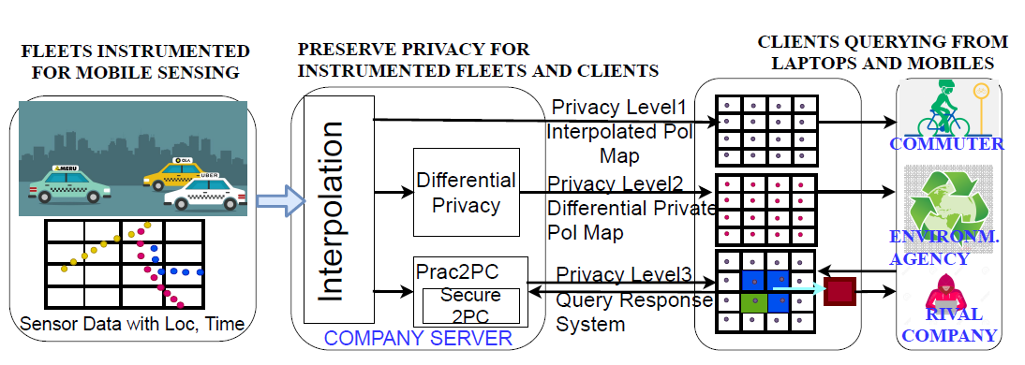
End-to-end 2PC system
Notes:
Our end to end 2P system answers client queries on interpolated maps, privately held by a fleet owner, through secure 2-party computation mechanisms. The client obfuscates query location within a larger geographical area to preserve its privacy. To maintain fleet privacy and prevent fine-grained fleet information leakage per grid, the fleet server answers queries aggregated over more than threshold number of grid points. We give -DP guarantee to the aggregated response by adding noise. This DP further protects fleet privacy against smartly crafted subsequent 2PC queries intersecting at one grid location, whose privacy can be compromised otherwise. Since, the information granularity is reduced to the server’s aggregation threshold, the noise added to aggregate answers is lesser compared to the noise added per grid points of interpolated public map. Hence, data utility is maintained at the server’s grid aggregation level.
there can be privacy leaks from the interpolation results. Location and density of vehicles in the sensing fleet can be inferred even from uniformly sampled grid points. We then explore Differential Privacy (DP) [12] to publicly release the interpolated maps with DP guarantee. This allows full privacy to clients who can ask any query, with minimal overhead, on the public maps without revealing query locations. However, the DP scheme gives questionable DP privacy to fleet owners,
due to inherent correlations in pollution values among nearby areas. Also, since DP adds noise to interpolated output for privacy, it reduces utility of the sensed and interpolated values for clients.

Slide 32
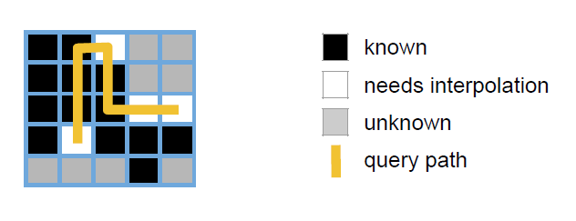
2-Party System
Client - ask queries from only a single server
Server - Only perform interpolation on its own data
Queries accurate only in areas where one cab company's fleet is located

Slide 33
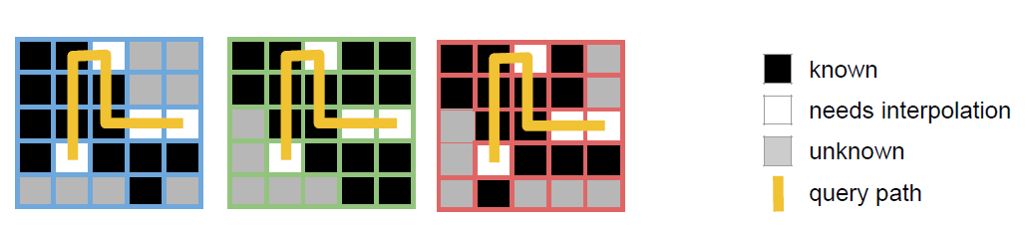
Multi-Party System
Client - asks queries from multiple servers
Server perform joint interpolation
Queries answered using more data — more reliable predictions

Slide 34
Two methods
Better predictions for unknown locations
Tackles sparse data at each server
Step1
Server interpolation
Secure aggregation of interpolated grids
Step2
Step1
Secure sharing of private grids
Secure joint interpolation
Step2
Secure query answering
Step3
Notes:
There can be two ways to proceed in multi-party systems
• First, each server does interpolation independently on its own data and then we merge pollution predictions from different servers for the same points and then answer client pollution.
queries.
• Then we extend this to secure interpolation across servers, where servers collectively interpolate their data and then securely answer queries. Since the data at each server is sparse, the joint interpolation leads to better predictions for unknown locations.
1. Train privately, inference securely
2. Train securely
Data utility vs Privacy
1. More like Fed learning
Data sparse at each server
1. each server train separate model, share private interpolated grid
2. each server train a single model shared privately, model updates – fed learning
3. data securely shared to train a model using MPC
3. data securely shared to train a model using MPC
4. Split learning ?
Why 3 because data at each server is v sparse and we want to train our model on shared grid for more data utility >>

Slide 35
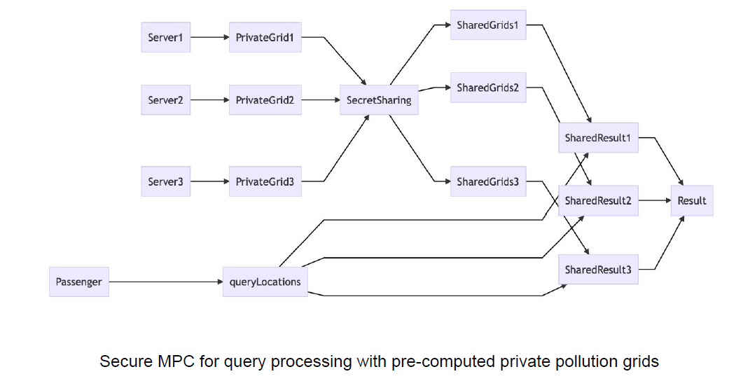
Interpolation
Interpolation
Sparse Data
Notes:
Here is the Query answering pipeline by merging interpolated grids. Depending on the two cases, we can perform interpolation at two different steps which leads to privacy vs utility tradeoffs.
However, performing the interpolation together using data from all the server leads to better interpolation and take care of insufficient data at individual servers.

Slide 36
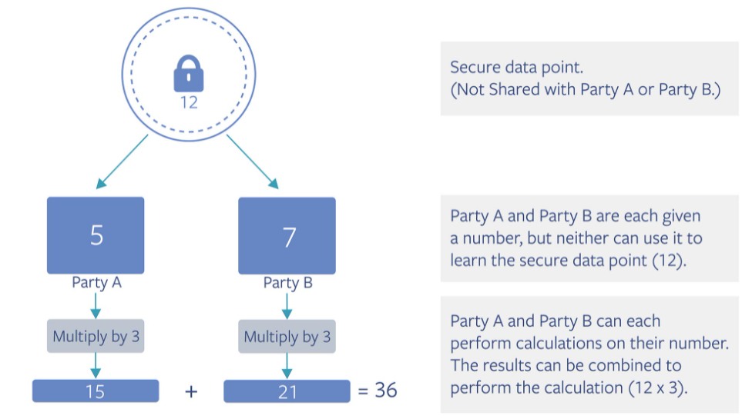
Secure MPC
Notes:
We use Secure MPC to encrypt the data.
Secure multi-party computation is an abstraction that allows multiple parties to compute a function on encrypted data. The protocols are designed such that every party is able to access only their own data and data that all parties agree to reveal. A secure MPC, performs the trusted computation without leaking a party’s information to others. In our project we explore the library Crypten which is based on secretsharing protocols.

Slide 37

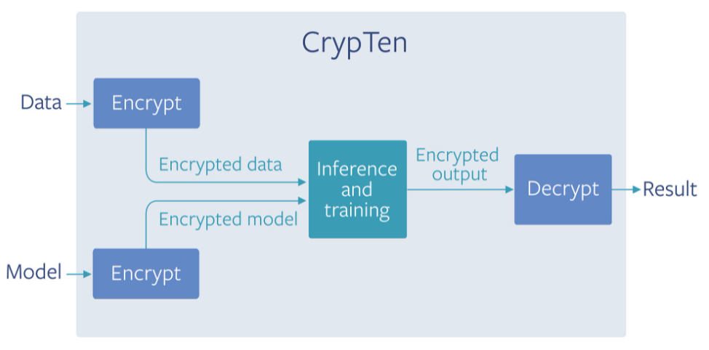
CrypTen
Notes:
CrypTen is a Privacy Preserving Machine Learning framework written using PyTorch that allows to train models using encrypted data. It currently implements Secure Multiparty Computation as its computing backend. Data and model I encrypted and shared between clients for secure training and inference.
Addition is carried out by simply asking the parties to sum their secret shares and multiplication using Beaver Triples. All linear functions are represented as a combination of addition and multiplication and all non-linear functions are implemented using standard approximations which use addition and multiplication.

Slide 38
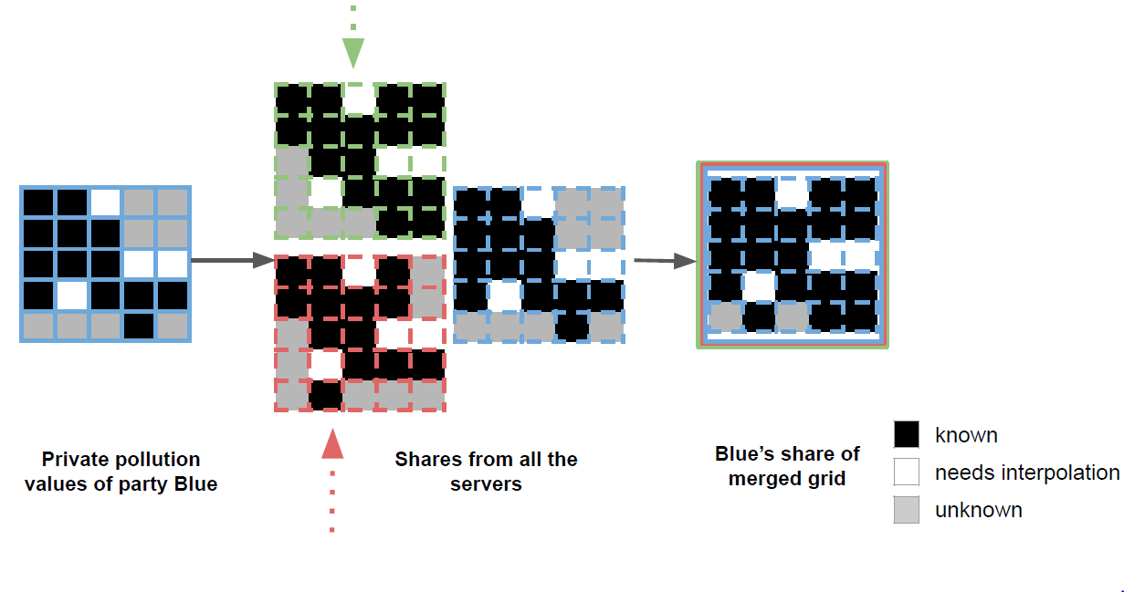
Notes:
The city is divided into grid. The servers have their respective pollution values at different grid points. They secretly share these values and averaging is done on all known points. For the unknown points, we perform interpolation. The interpolation needs to be done securely and the interpolated values are all secure and shared. However, the data is relatively sparse with only values for 2% grid points known in an hour.

Slide 39
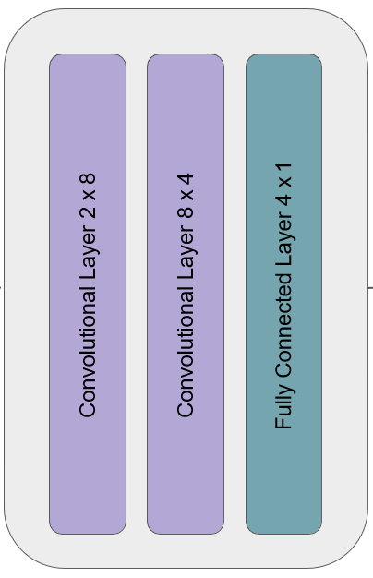
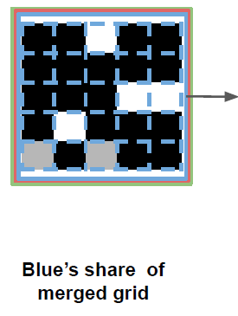
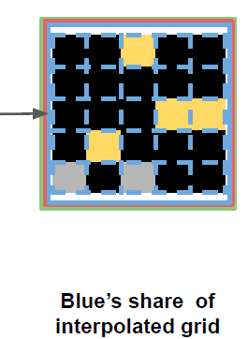
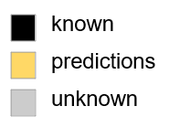
GCN Architecture for interpolation
Notes:
The servers with their private grids, they merge their data using MPC and now have secrets share of the merged grids. The GCN architecture involves two graph convolution layers followed by a fully connected layer. The training happens securely between parties so that the model learned is shared between them. Finally, predictions are made on the test points with the result for the entire grid now stored securely in a shared way between all the parties.

Slide 40
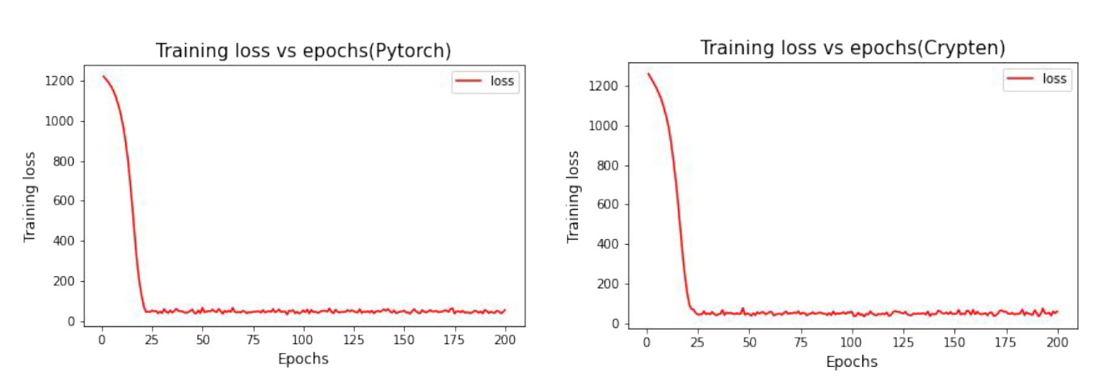
Training in Crypten
Notes:
While training, Crypten performed as good as the standard Pytorch implementation as evident from Figure

Slide 41
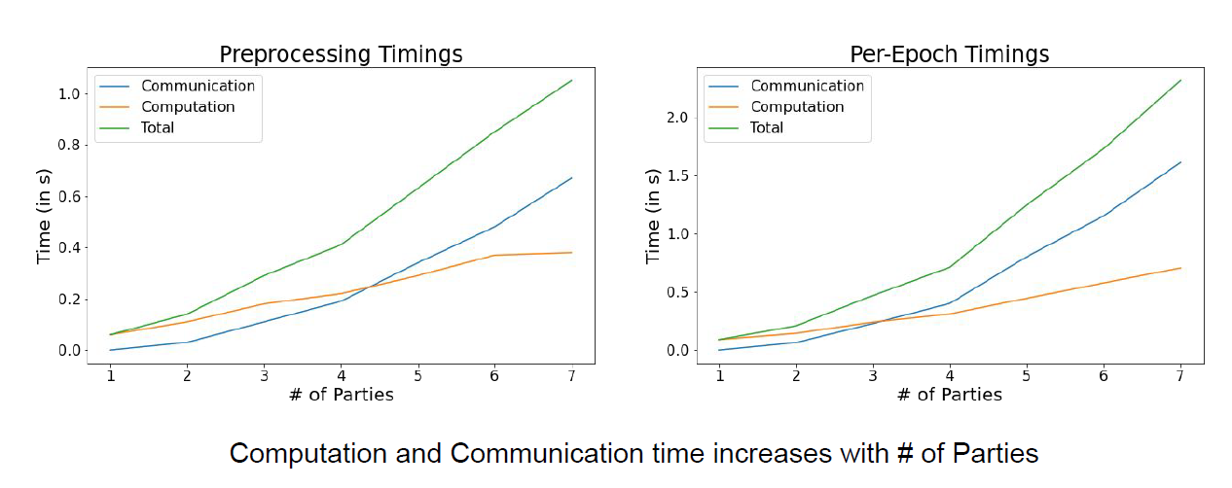
Training times
Notes:
In terms of time, Crypten is almost 100 times slower than Pytorch. For communication v/s computation breakup of Crypten we
will analyse two stages of training separately,
As we increase the number of parties, the communication time starts to dominate which is as expected. However, we see that the computation cost also increases slightly, this is because as the number of parties increases more grids have to be aggregated.

Slide 42
Utility vs Privacy
Low communication overhead
Med communication overhead
Data Utility
High communication overhead
Training model
Sharing wisdom
Crypten Model Training
Infer
Obfuscate
Smash
Secure MPC
Data Privacy

Slide 43
Different techniques
Differential Privacy
Federated Learning
Secure MPC – Encryption
Split Learning

Slide 44
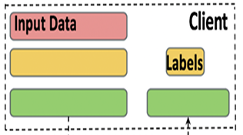
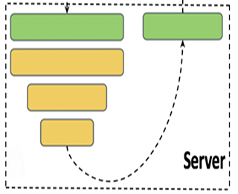
Split learning
Notes:
The input is graph of grid with each fleet company having its own accumulated pollution values. The labels are the pollution PM values which are also private as it reveals locations where the values are present. Location and density of vehicles in the sensing fleet can be inferred from these labels.
So, depending on the topology of the system, we can use this U-shaped trained process using split learning.

Slide 45
Split learning
But the data at each client is very sparse
Notes:
However, in split learning the each client will train the model in a sequential manner with their own graph. The graph at each fleet server is very sparse with only values accumulated from its vehicles locations. The graph also can be skewed in concentration with certain cabs/fleet companies enjoying monopoly over others in certain regions.

Slide 46
Split learning
But the data at each client is very sparse
Can we pool the data from each fleet and train on a merged grid?
Notes:
In this case, it makes sense to pool the data together from all these multiple fleet and clients and perform interpolation on the merged grids.

Slide 47
Split learning
But the data at each client is very sparse
Privacy
Vs
Data Utility
Can we pool the data from each fleet and train on a merged grid?
Notes:
But this leads to data utility vs privacy tradeoffs that we have.

Slide 48
Future scope..
Data at each server is sparse and skewed?
Attacks (malicious server and clients)
Efficient cut layer based on computation load and leakage at client
Notes:
Data at each server is sparse and skewed? Weights update abrupt If trained sequentially (non-IID setup).

Slide 49
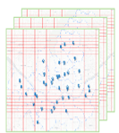
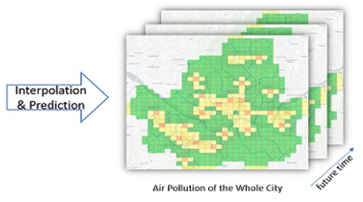
Further…
Time series streaming pollution data
Data utility
Privacy
Computation time
Spatio-temporal pollution data

Slide 50
THANK YOU!

Slide 51
Neural Radiance Fields
NeRF: Representing Scenes as Neural Radiance Fields for View Synthesis

Slide 52

Notes:
Look at the tree in this figure. Now imagine you are given pictures of this object of different sizes and viewing angles. And you have to come up with a system that generates a picture of the object as if it is viewed from any direction
Ie. Just from a few input pictures, you want to generate image of object from any direction. This is a non-trivial task and the goal of nerf is view synthesis

Slide 53
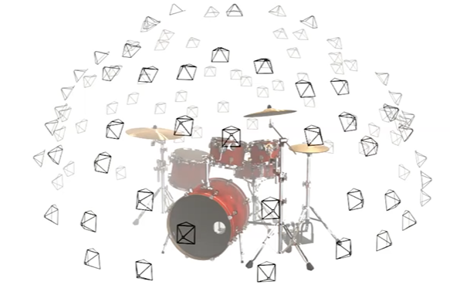
View Synthesis Task Description
Notes:
Now given a bunch of images i.e. a sparse set of input images of this scene, drums in this case from different viewing directions, we want to generate views from different positions.
This is done by optimizing an underlying continuous volumetric scene function using a sparse set of input views.
This is very different from classical training where we have training and test set for a general task to learn. Here We want to overfit a neural network for a single scene. That means if we want to learn a new scene, we will use a new neural network. Now we use the given input images to completely overfit for this scene, i.e. the weights of the neural network now represent the scene

Slide 54
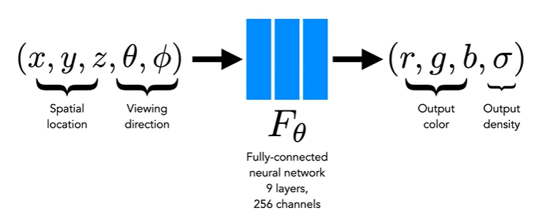
NeRF Core Concept
Notes:
The network gets two things as input, the position in the 3-D coordinate system and the viewing direction. And the output of the network is the colour and the density at the viewing diection. The density tells us if there is something or not at the location and colour tells the colour at that position

Slide 55
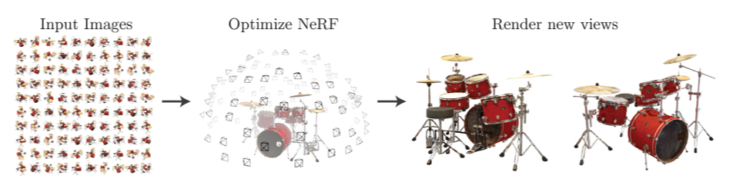
Problem Introduction
Notes:
So here is the task. We have a set of input images of the scene. Next we want to determine the camera angle and the position it is taken from. And now we want to render new views of this scene from any position and direction

Slide 56
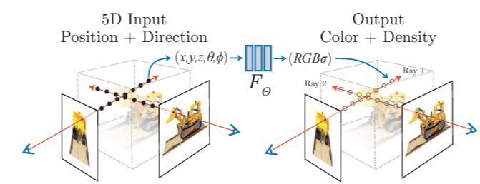
Generating views
Notes:
How we can use a Nerf is as follows.
Now if we want to render an image. We take a pixel, shoot a ray, and we sample along the ray and ask the network, what is the there. The network will tell if there is something there and what colour and density. And we use volume rendering to reder the final image
Our algorithm represents a scene using a fully-connected (nonconvolutional) deep network, whose input is a single continuous 5D coordinate (spatial location (x,y,z) and viewing direction (θ,φ)) and whose output is the volume density and view-dependent emitted radiance at that spatial location.

Slide 57
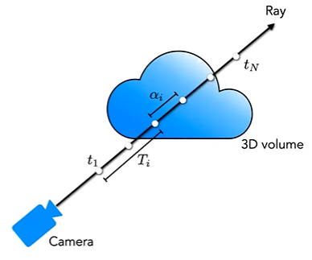
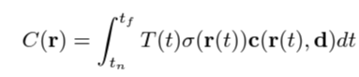
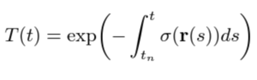
Radiance Field Volume Rendering
Probability of
reaching
Density
Colour
Notes:
Our 5D neural radiance field represents a scene as the volume density and directional emitted radiance at any point in space. We render the color of any ray passing through the scene using principles from classical volume rendering
To render the colour, we integrate from the near bound to the far bound
Where The function T(t) denotes the accumulated transmitance along the ray from tn to t, i.e., the probability that the ray travels from tn to t without hitting any other particle
So, in this integral, we have T -> prob ray reaching at that point, the density at the particular point -> and then adopts the colour at that point

Slide 58


Training the NeRF from sparse views
Notes:
So, how we can train the model is. We iterate through pixels in image, shoot the ray and render the ray through current randomly initialised NN
Now if we already have an image of that scene from the input set, we can calculate a loss depending on what the network tells you is there in terms of colour and density and what actually is there.
We minimise sum of errors between the rendered value and the observed pixel value. So using the set of input images, we can now use them to train the model to overfit about this scene and the model now represents the scene in its weights.
Now many tricks are used here as
the network is restricted to predict the volume density σ as a function of only the location x, while allowing the RGB color c to be predicted as a function of both location and viewing direction. The reason being the volume density does not depend on the viewing direction. Now, if something is transparent, it is going to be transparent from all the directions.

Slide 59


Results
~ 5MB
Notes:
It produces really good realistic rendering, capturing all the lights and colours.
It allows to store a scene with much less memory. For example it requires only 5 MB for the network weights which is even less memory than the input images alone for a single scene. Whereas a large 3D voxel grid for every input image, results in enormous storage requirements (over 15GB for one “Realistic Synthetic” scene). So, this is really good in storing the scenes and rendering later.

Slide 60
Normalising Flows
Flow-based Deep Generative Models

Slide 61





Generative Models
Generative Adversarial Networks
(Adversarial Training)
Invertible Flow based Generative Model (Maximize exact data likelihood)
Variational AutoEncoder
(Maximize lower bound on data likelihood)
Notes:
Generative modeling is an unsupervised learning task in machine learning that involves automatically discovering and learning the regularities or patterns in input data in such a way that the model can be used to generate images
GANs: these are based on adversarial training between generator and a discriminator and there is no maximum likelihood training. However, these models are and suffer from issues such as mode collapse.
VAE: Variational autoencoders (VAEs) that have an encoder and a decoder, which maximise a lower bound on the log-likelihood of the data.
We will now talk about flow based generative models. These models have gained much recent attention in research community compared to GANs and VAEs. These models maximise an exact log likelihood of the data distribution.
In VAEs, one is able to infer only approximately the value of the latent variables that correspond to a datapoint. And GAN’s have no encoder at all to infer the latents. In reversible generative models, this can be done
exactly without approximation. Not only does this lead to accurate inference, it also enables optimization of the exact log-likelihood of the data, instead of a lower bound of it.

Slide 62



Change of variable formula
Volume correction
Notes:
Let’s review the change of variable theorem specifically in the context of probability density estimation, starting with a single variable case.
Given a random variable z and its known probability density function z∼π(z), we would like to construct a new random variable using a 1-1 mapping function x=f(z). The function f is invertible, so z=f−1(x). Now the question is how to infer the unknown probability density function of the new variable, p(x)?
where det∂f∂z is the Jacobian determinant of the function f

Slide 63




Normalising flows
Notes:
So, we a call a sequence of bijective transformations - Normalising Flows
After z is initially sampled, it flows through this sequence of transformations with its density function re-normalised at each step – to ensure that it is valid

Slide 64






Flow-based Generative models
Reversible Transformations
Simple Latent Space Distribution
Complex Image Space Distribution to be learned
Point in latent space
Point in image space
Notes:
These are reversible transformations from simple latent space distribution to complex image space distribution. i.e starting from a normal distribution of the image space, we do invertible transformations to learn the complex distribution of the image space. This specify an invertible mapping between a set of latent variables Z and a set of observed variables X.

Slide 65


Exact latent inference
VAE
Taking log both sides
Taking log both sides
Lower bound on log-likelihood
ELBO
GAN
Exact log-likelihood
No likelihood inference
Exact posterior inference
Notes:
Normalising flows allows to parametrize the likelihood as a flow. As before, the latent variable z is passed through bijective transformations and we obtain the likelihood as computed before.
Taking log on both sides gives us the exact log-likelihood and allows us to directly train our model via maximum likelikood. In VAEs we can only approximate the lower bound on the log-likelihood, known as ELBO whereas in GANs we donot compute the likelihood at all.
The flow basd framework allows for exact posterior inference. Infact the invertibility of f guarantees that we can find unique z that generates a given x.
In VAEs the encoder parametries the approximate posterior, GANs have no way of latent variable inference

Slide 66



Glow: Generative flow model
Notes:
Glow is a type of reversible generative model, also called flow-based generative model, and a major breakthrough that gathered everyone’s attention about normalizing flows.
1. Exact latent-variable inference and log-likelihood evaluation.
2. Efficient inference and efficient synthesis.
3. Useful latent space for downstream tasks which allow for various applications such as interpolations between datapoints and meaningful modifications of existing datapoints.
The Glow (Kingma and Dhariwal, 2018) model extends the previous reversible generative models, NICE and RealNVP, and simplifies the architecture by replacing the reverse permutation operation on the channel ordering with invertible 1x1 convolutions.

Slide 67
THANK YOU!

